Slide 1


World GDP and Population Correlation Application
Caleb Trimble
Bellevue University
DSC400
Professor Ismaily

Slide 2
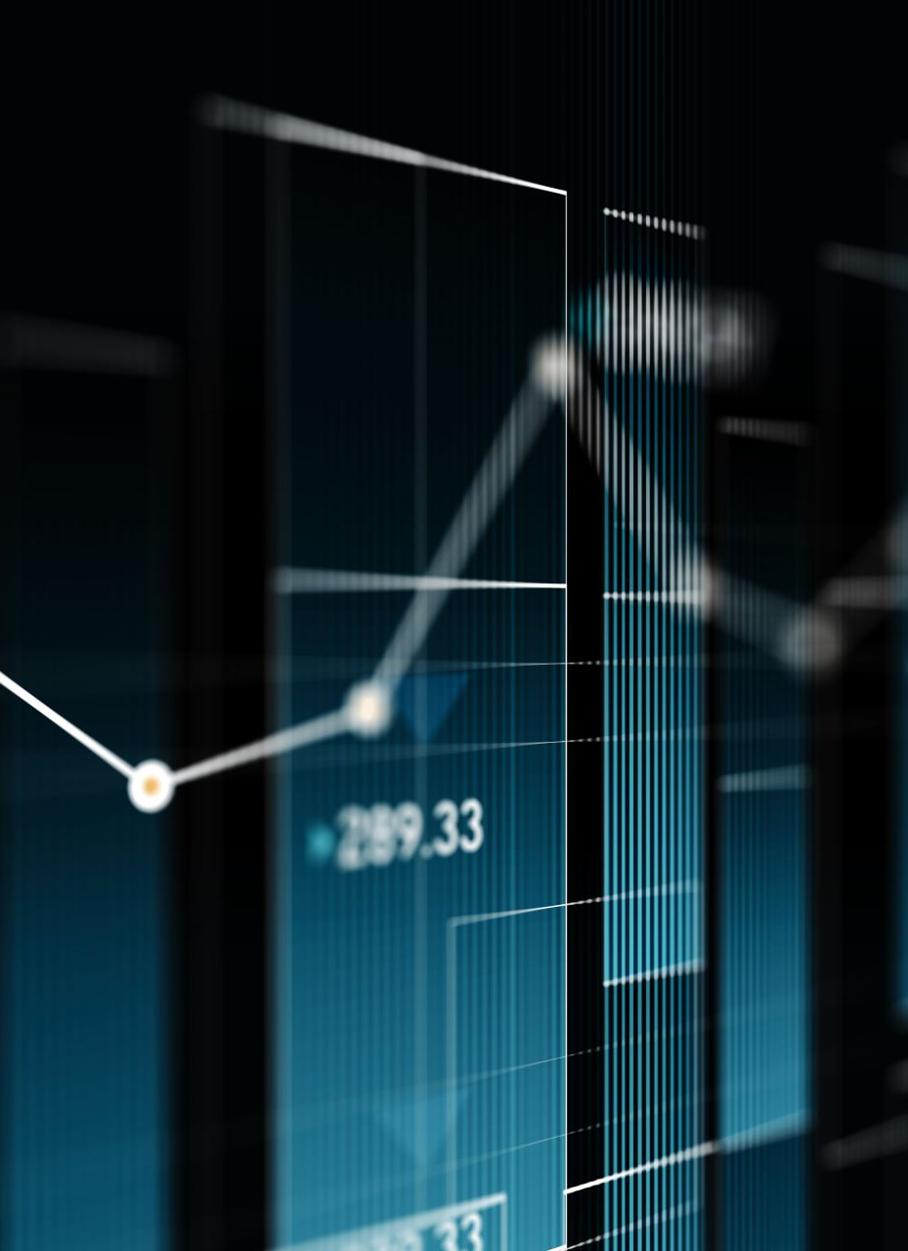
Problem Statement
Develop a comprehensive dashboard that integrates and visualizes GDP and population data across multiple years.
Provide insights into the correlation between population size and GDP, identify outliers, and highlight trends and patterns in economic data.

Slide 3
Project Goals
Standardize and merge
Standardize and merge population and GDP datasets from reliable sources.
Implement
Implement interactive visualizations, including scatter plots and choropleth maps, to illustrate the relationships between population and GDP.
Identify and analyze
Identify and analyze outliers to understand the unique economic factors contributing to their high GDPs despite smaller populations.
Provide
Provide a detailed statistical analysis, including OLS regression results, to quantify the correlation between population size and GDP.
Offer
Offer predictive insights through deep learning models, forecasting future GDP values based on population trends.

Slide 4
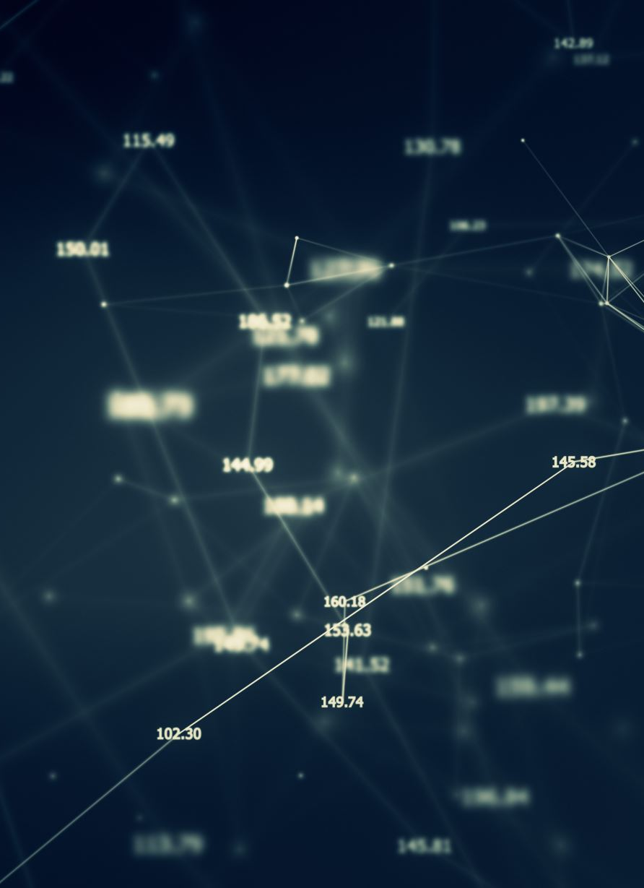
Approach (Data Collection/Preprocessing)
Source Identification: Identify reliable sources for GDP and population data, such as the World Bank, OECD, and Kaggle.
Data Acquisition: Download the datasets in CSV format and ensure they cover multiple years to enable temporal analysis.
Standardization: Clean and standardize column names to ensure consistency across datasets. This includes stripping whitespace, replacing special characters, and applying consistent naming conventions.
Country Name Mapping: Create a comprehensive mapping dictionary to reconcile inconsistent country names across datasets, ensuring accurate merging.
Handling Missing Data: Identify and address missing data points through imputation or removal, using statistical methods where appropriate.

Slide 5

Approach (Data Integration)
Merging Datasets: Merge the population and GDP datasets based on standardized country names using appropriate join operations.
Normalization: Normalize key variables, such as population and GDP, using techniques like Min-Max Scaling to facilitate meaningful comparisons.

Slide 6
Approach (Exploratory Data Analysis)
Descriptive Statistics: Calculate summary statistics (mean, median, standard deviation) to understand the distribution of variables.
Visualization: Use scatter plots, histograms, and box plots to visualize the relationships between population size and GDP, identifying any patterns or outliers.

Slide 7
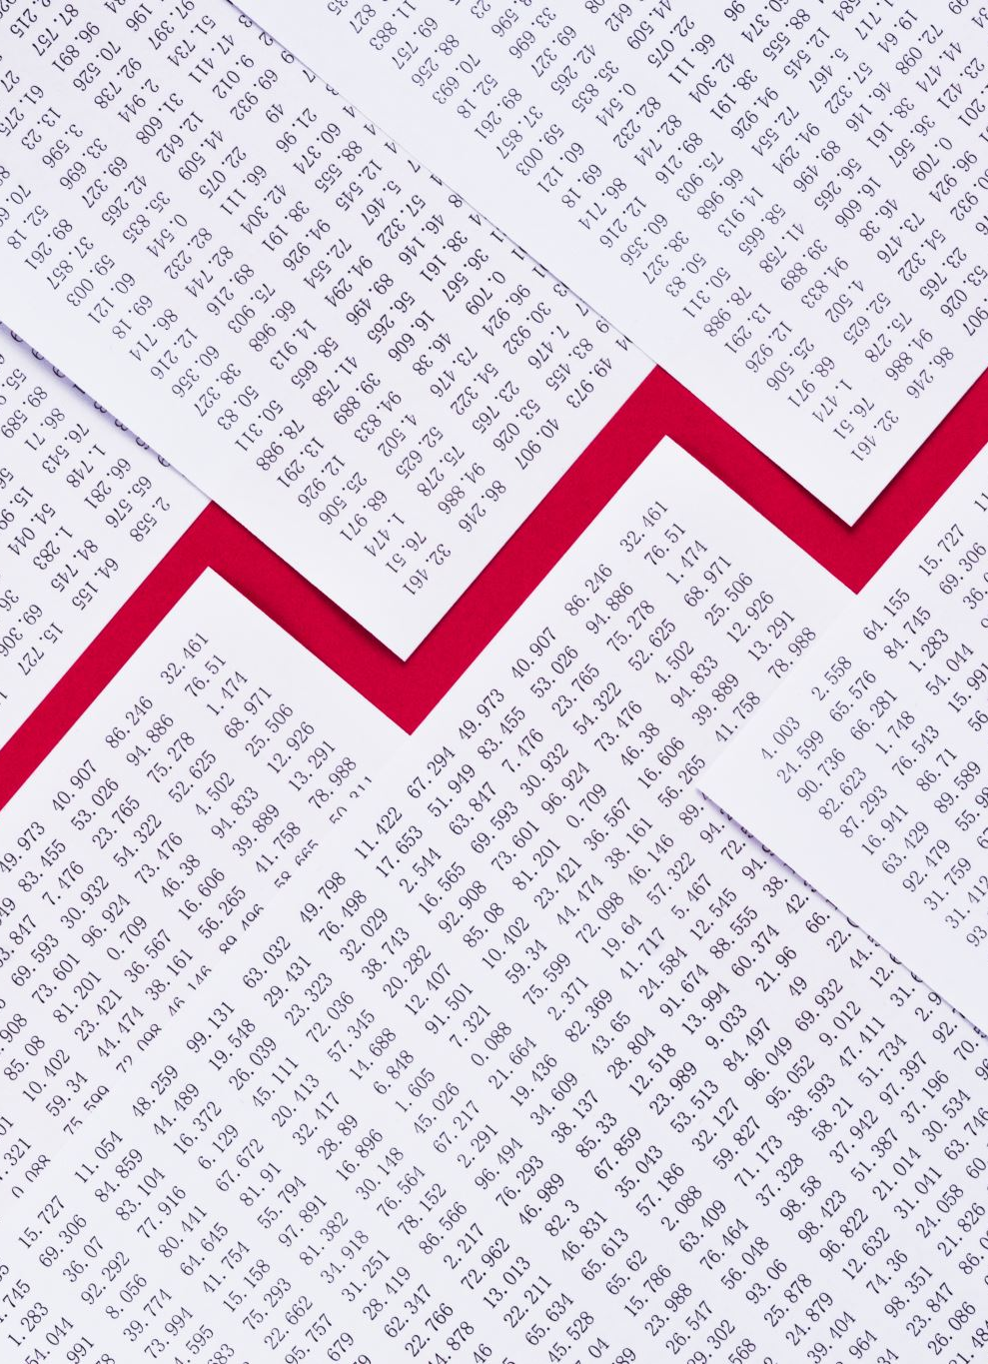
Approach (Statistical Analysis)
OLS Regression: Perform Ordinary Least Squares (OLS) regression to quantify the correlation between population size and GDP.
Model Interpretation: Interpret the regression coefficients, standard errors, t-values, and p-values to understand the significance and strength of the relationships.

Slide 8
Approach (Predictive Model)
Deep Learning Model: Develop a deep learning model using neural networks to predict GDP based on population size and other relevant features.
Model Training: Split the data into training and testing sets, train the model using appropriate optimization techniques, and validate its performance using metrics like mean squared error and validation loss.
Model Evaluation: Evaluate the model's performance on test data, assess its accuracy, and visualize the actual vs. predicted GDP values

Slide 9
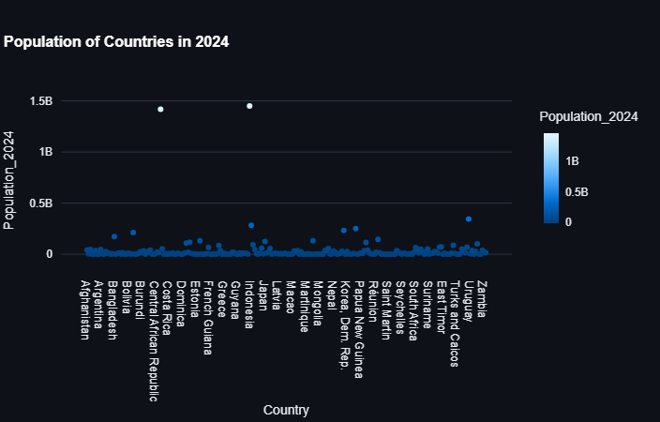
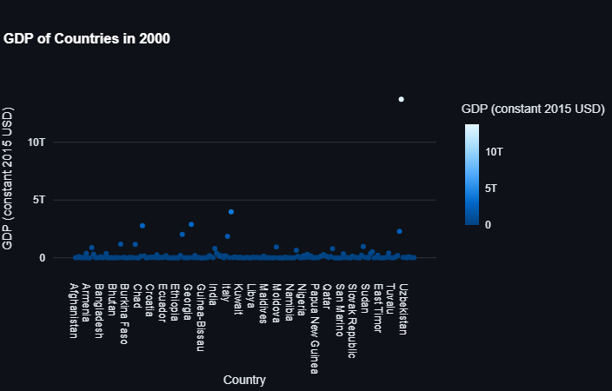
Interactive Visualizations and Dashboard
Scatter Plots and Choropleth Maps: Create interactive scatter plots and choropleth maps using Plotly to visualize the relationships and distributions of GDP and population data.
Streamlit Dashboard: Develop an interactive dashboard using Streamlit, allowing users to explore the data, select different years, and view various visualizations and statistical insights.

Slide 10
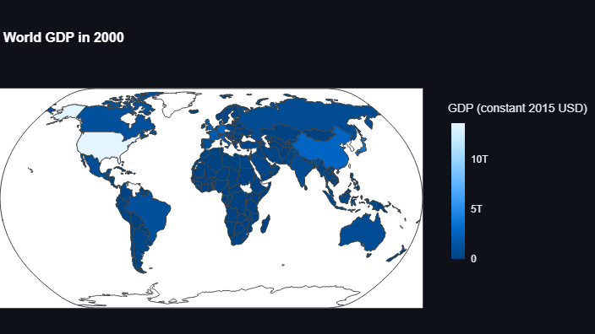
Interactive Visualizations and Dashboard (Cont.)
Interactive map that highlights countries by GDP.
When hovered over, the text box shows:
Country Name
Global Domestic Product
Population
And Rank

Slide 11
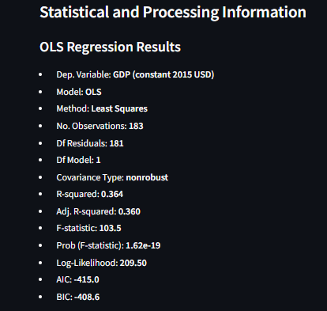
Regression Model
Application provides user with all significant backend information including
Statistical Model results,
Machine Learning accuracy
Raw data

Slide 12
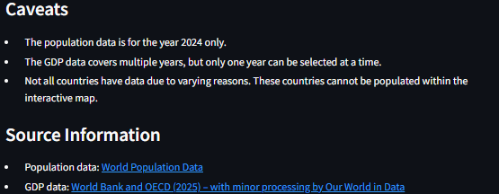
Caveats and Data Sources
At the bottom of the application there are necessary caveats about the data.
Data Sources are listed with links to the original source data.

